Slide 1
Why use blockchain instead of a DB?
(a conceptual inquiring journey)
Gheorghe Curelet-Balan KW Intersections meetup, Feb. 19, 2019
    @curelet

Slide 2
Agenda
Understanding blockchain via Bitcoin operation
Ethereum blockchain smart contract, as a:
  Value transfer feature
  Process automation enabler
Business blockchains value proposition, to:
  streamline data exchange & process automation between partners
  Incentivise trusted data write behaviour
Plea towards blockchain use in any transactional desired scenario

Slide 3
Who am I?
Interested in researching the latest advancements in software technologies / process (blockchain, ML, AI, web, cloud, mobile, enterprise, agile)
Computer science Math 4 year 1983 graduate (Magna cum Laude) in Iasi, Romania
10 years of software engineering / testing / DB / technical project management at Romania’s biggest computer science research institute ITCI
6 years of industrial networks communication programming (PLC drivers gateway emulation & networks configuration Windows tools) at Molex & previous acquired businesses
2 years of mobile operating systems development at RIM / Blackberry
6 years programming of embedded telephony, VoIP, communication networks (integration, configuration, monitoring, security, DB, GUI) at GE Security / United Technologies
1 year of industrial automation / internet traffic filtering at PEER Group / Netsweeper

Slide 4
BITCOIN, the first implementation of a BLOCKCHAIN
When speaking of blockchain most people think of Bitcoin digital currency (coin).
It allows trusted anonymous peer-to-peer (P2P) public transfer of money (as bitcoins) all over the world
  without any intermediaries (banks, governments, etc.)
Bitcoin is implemented as a BLOCKCHAIN
  a trusted shared public ledger (log) of TRANSACTIONS
  maintained by an open decentralized, fault-tolerant NETWORK of computers

Slide 5
Bitcoin & Blockchain meaning
Shared trusted LEDGER
NETWORK of computers maintaining the ledger
COIN as network incentive and form of value storage & transfer

Slide 6
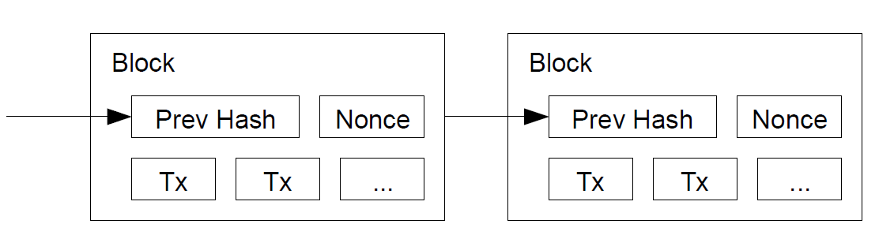
Blockchain ledger/log structure in a nutshell

Slide 7
Bitcoin as immutable ledger of assets
Ledger DB = permanent distributed shared recorded history of asset TRANSACTIONS (also called “Internet of Value”)
Transaction (Tx) = exchange of ASSETS
  Derived bitcoin requirements:
    Immutable (hard to change since asserts = value)
    Decentralized (assets --> no central authority) to enhance TRUST
    Ledger DB = storage of immutable history of Tx

Slide 8
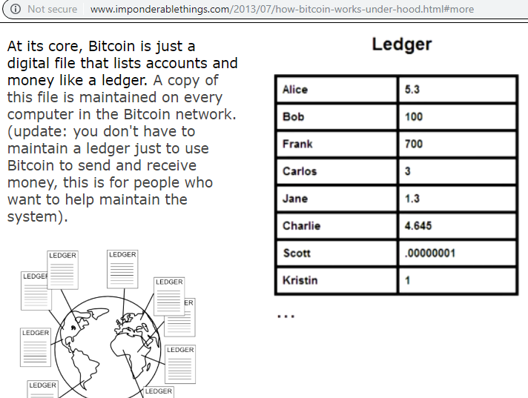
Bitcoin DB = List of account balances & history of all transactions since the beginning of chain

Slide 9
Reasons for Bitcoin birth
Failure of DB based CENTRALIZED payment transactions processing software architectures because:
  Are vulnerable, being single point of failure even if DB is distributed, e.g. financial DBs
  Of lack of built-in TRUST (intermediation makes it hard to solve disputes)
  Are subject to DOUBLE-SPEND attack, e.g. DigiCash centralization
  Cypherpunks libertarian crypto-anarchy voluntarism movement.
    Bitcoin launch triggered by lack of transparency & centralized bureaucracy failure in 2008 financial crisis
    Cypherpunks agenda: automation of voluntary economic interactions by decreasing the cognitive load to perform them e.g. coordinated automation of roads use & maintenance.

Slide 10
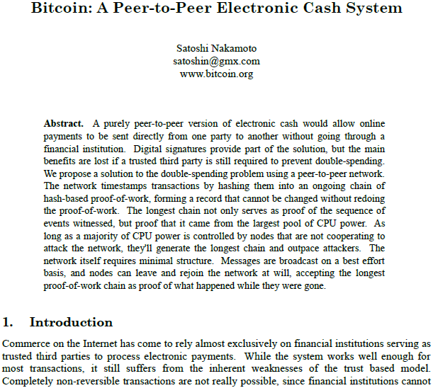

Slide 11
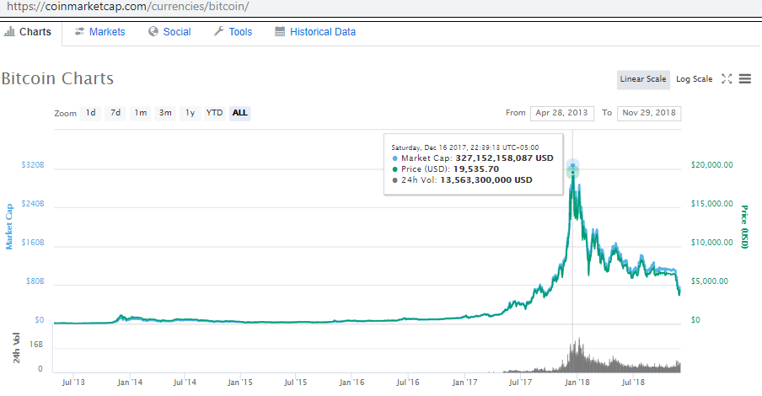
What's all the fuss about & what's the promise of this technology that is causing another speculative "tulips mania"?

Slide 12
Hype or revolutionary technology?
Bitcoin features:
ANONYMOUS users
PUBLIC shared ledger/log/DB (TRANSPARENCY = anyone can see all transactions)
OPEN / PERMISSIONLESS network. Anyone can join & participate in network operation (effective if participant has enough CPU power).
DISTRIBUTED (transactions are stored (1 block every 10 minutes) on each network node)
SECURE (hard to attack) since maintained by the distributed network (no single point of failure)
GOVERNED (network agreed) WRITE (append only write agreed by all nodes following a network consensus protocol). Makes the write to blockchain slow & expensive due to consensus overhead. Makes the ledger IMMUTABLE as time goes by.
TAMPER RESISTANT. Tampering with a block/Tx will invalidate the chain from there forward; chain needs to be rebuilt from the changed block, forward.
TRUSTED using cryptography (no disputes since each node can verify for itself the shared data in each block)
SCRIPTING feature. Limited ability to store & run scripts inside Tx

Slide 13
Bitcoin operation

Slide 14
Bitcoin Tx initiation details
User generates locally a cryptographic PRIVATE KEY using a wallet app or other tools
  Private Key is used to generate the PUBLIC KEY and a ADDRESS that identify the user (owner of funds) in the transactions on the network
Private key is used to digital sign the transactions against tampering
User initiates a Tx to transfer (buy, sell, send) funds with another bitcoin user using his Bitcoin address
User’s client app sends Tx over the Bitcoin network (Tx is unconfirmed)
User waits for Tx confirmation

Slide 15
Bitcoin OWNERSHIP assured by
ASYMMETRIC cryptography
Private key
Public key
Bitcoin address

Slide 16
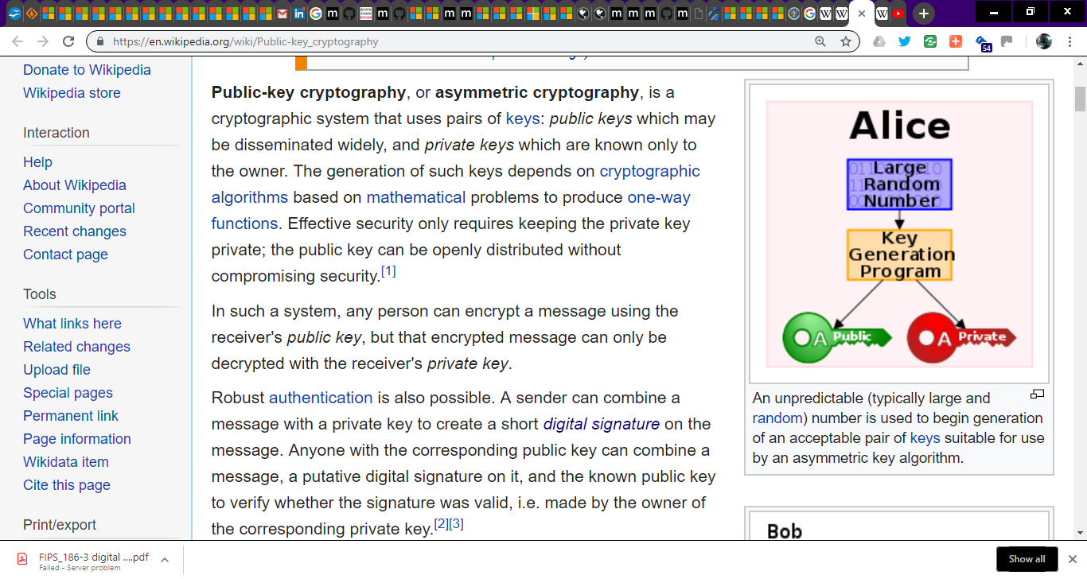

Slide 17
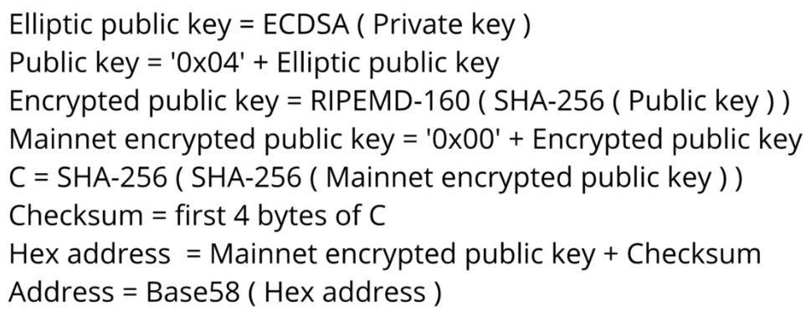
Bitcoin account
Like a public drawer whose random label is derived from the private key
  e.g. generate public / private key pair at Bitaddress.org
  Bitcoin address algorithm:

Slide 18
Building Transactions (Tx)

Slide 19
Building Tx
Specify amount
Specify destination addresses
Wallet app
  Uses user’s private key to DIGITAL SIGN Tx
    Verifier uses user’s public key to check if he initiated Tx

Slide 20
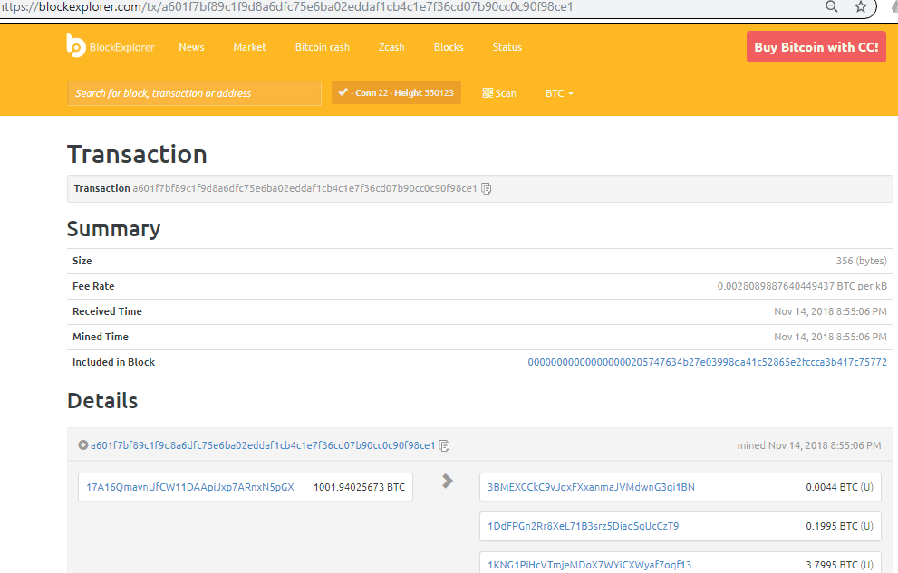
A bitcoin TRANSACTION as shown in https://blockexplorer.com

Slide 21
Digital Signature

Slide 22
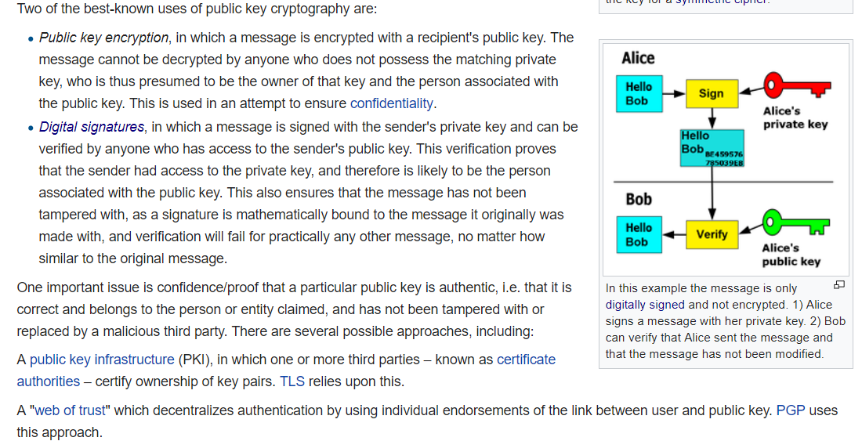

Slide 23
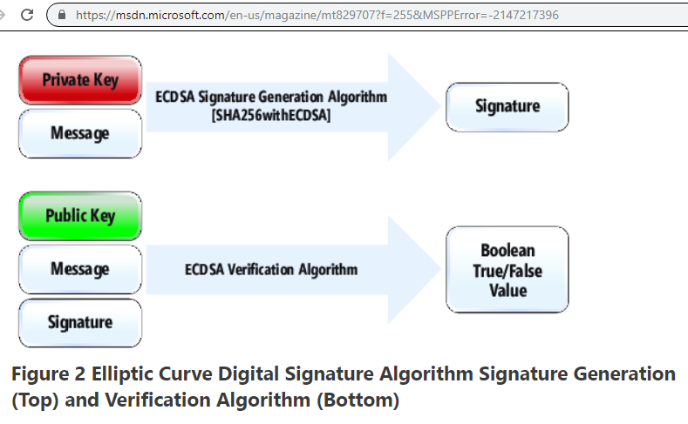

Slide 24
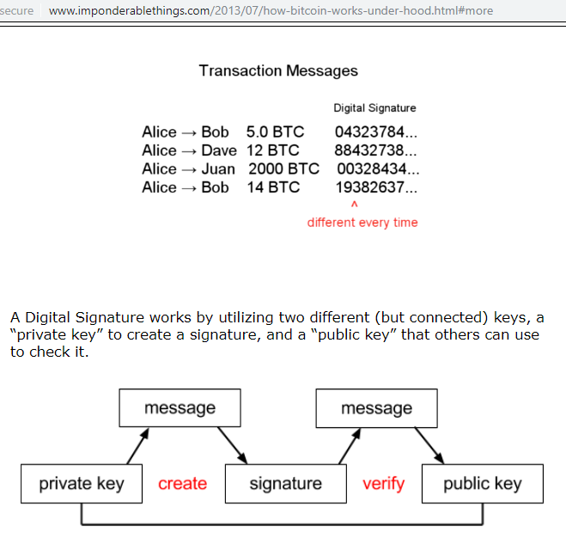

Slide 25
Understanding Bitcoin blockchain
How it operates perspective

Slide 26
Bitcoin network competes to build next block
Step 1:
All unconfirmed Tx sent by clients are propagated throughout the Bitcoin mesh network.

Slide 27
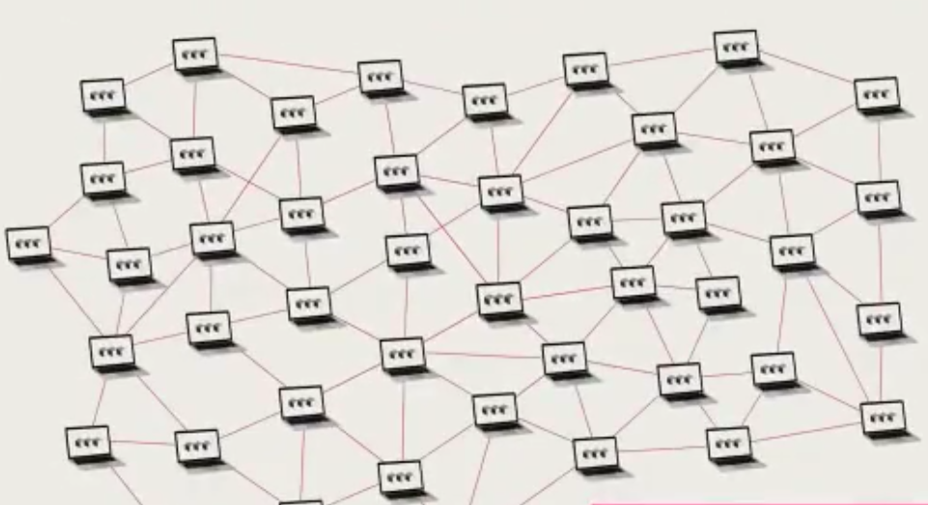
Bitcoin decentralized P2P network (CIGI view)

Slide 28
Bitcoin network
a.k.a. DLT network (Distributed Ledger Technology).
Mesh network of 10K nodes (https://bitnodes.earn.com). Each node connects with few neighbours who relay the traffic (Tx & block forwarding)
Clients communicate with the nearest node
No single point of failure
The network offers trust & protection against attacks by periodically (10 min) peer block replication (1 block at a time) & selectively offering the write privilege to a peer via PROOF OF WORK (PoW) protocol.
Trustless & BFT (Byzantine Fault-Tolerant). The network can have malicious nodes. Bitcoin PoW protocol guarantees ledger integrity as long as 51% of nodes are honest.

Slide 29
Bitcoin network competes to build next block
Step 2, Block Creation:
Each node (miner) busy with current block, shelves Tx for consideration in next block at approx the next 10 minute heart beat.
Once current block is finalized (via PoW), the 10 minutes race to build next block begins
Each node collects most (or all) unconfirmed transactions into a block up to 1MB size limit (block size is a debatable issue in Bitcoin). Tx selection depends also by the Tx fee paid to miner
Due to network delay in Tx propagation the blocks built by the farthest apart nodes might be different. PoW will decide which block wins.

Slide 30
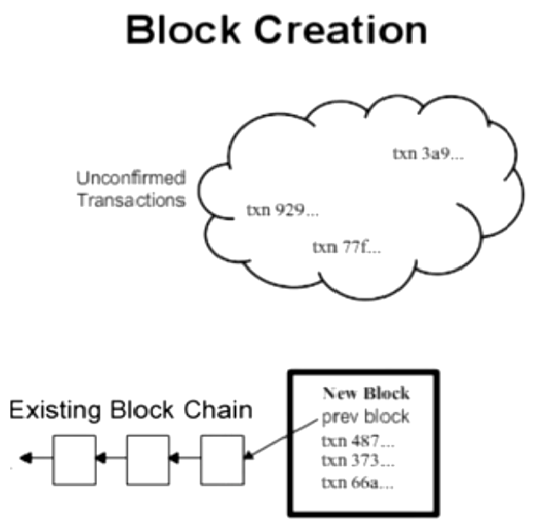

Slide 31
Algorithms used to build a tamper proof block
SHA256 hashing algorithm
  used to digital fingerprint Tx & block
Merkle tree algorithm
  used to digital fingerprint all Tx
    To prove fast if a Tx is part of the block

Slide 32
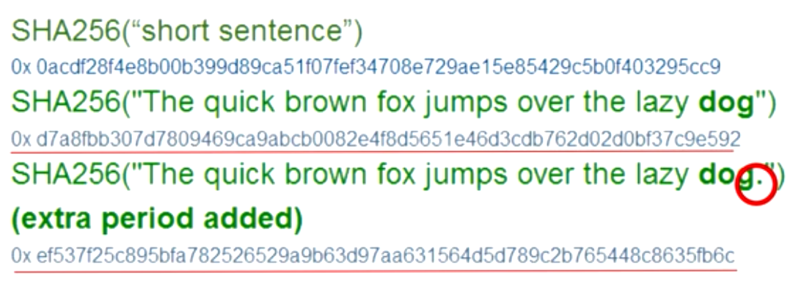
SHA256 Hashing
One way function offers unique numeric identity (256 bits hash) to any digital content. Hash is highly sensitive to change.

Slide 33
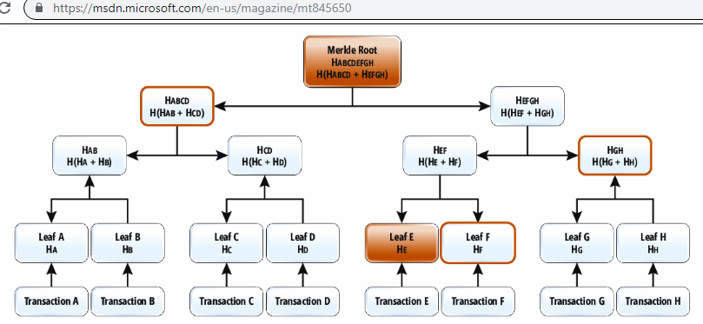

Slide 34
Building a tamper proof block
Block structure:
  Block’s header hash
  Collection of all Tx
  Header
    Previous block header hash
    Merkle root hash (a digital fingerprint of all Tx)
    Nonce
A Merkle Tree is built with all Tx
The Merkle tree root hash is set in block’s header
Block’s header hash is decentralized competitive determined by the network

Slide 35
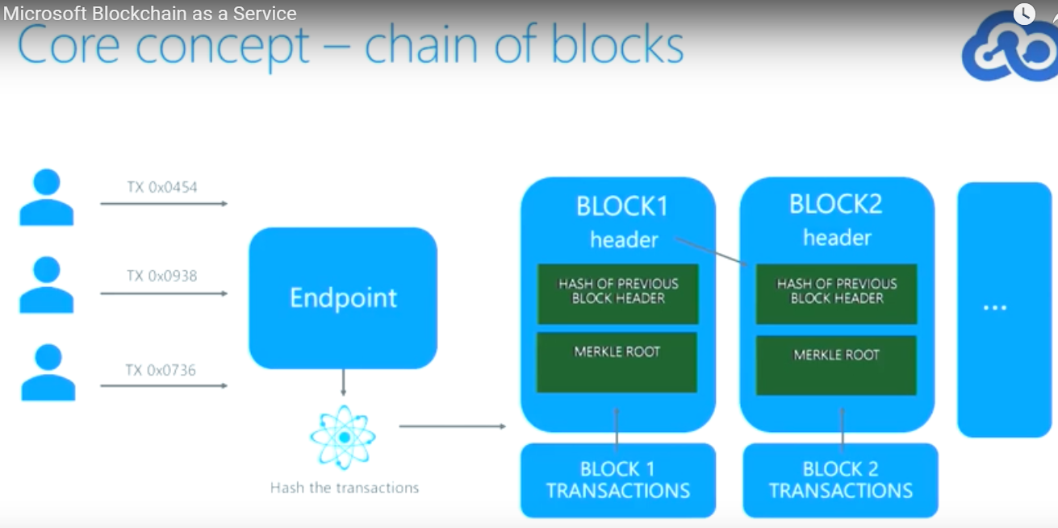

Slide 36
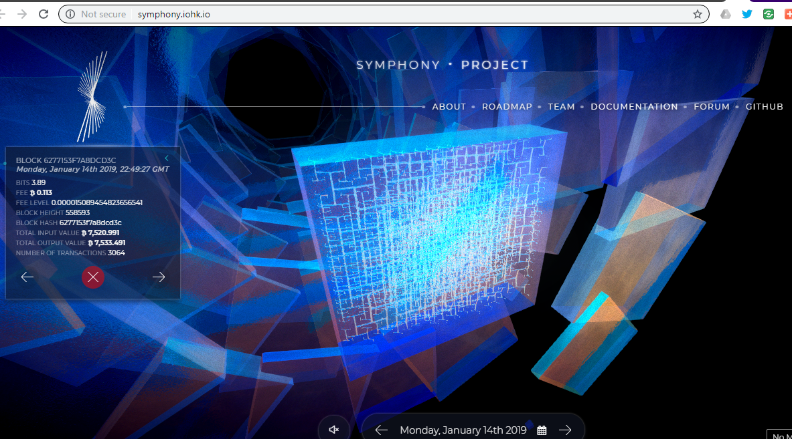
Symphony of Blockchains
Bitcoin chain visualization

Slide 37
Blockchain v.s. DB
Data tamper protection by using heavy cryptography & chaining of blocks.
  Hash chain v.s. independent DB records
    Each block’s hash is a fingerprint off all the previous data in the chain since the beginning (the genesis block)
      Altering any data will invalidate hash of the last current block

Slide 38
Bitcoin network competes to build next block
Step 3:
RANDOM NODE SELECTION of chain extension privilege. Proof of Work (PoW) algorithm. Inspired by Adam Back’s Hashcash PoW used to limit spam in message boards.
  Each node competes to solve a CPU intensive simple math puzzle with a common target to all nodes
  A nonce in block's header is incremented till computed block's hash is less than network's target hash ( "difficulty" hash should start with a predefined number of zeros 0x0000000000000....). Kind of bingo game.
  Difficulty is dynamically adjusted (every 2 weeks) to result in mining time being around 10 min depending on majority miners CPU power)
  CPU power measured in Mega hashes per second

Slide 39
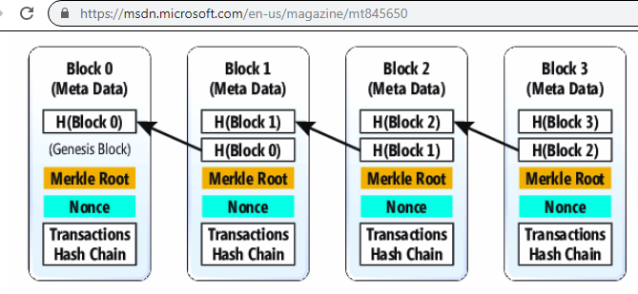

Slide 40
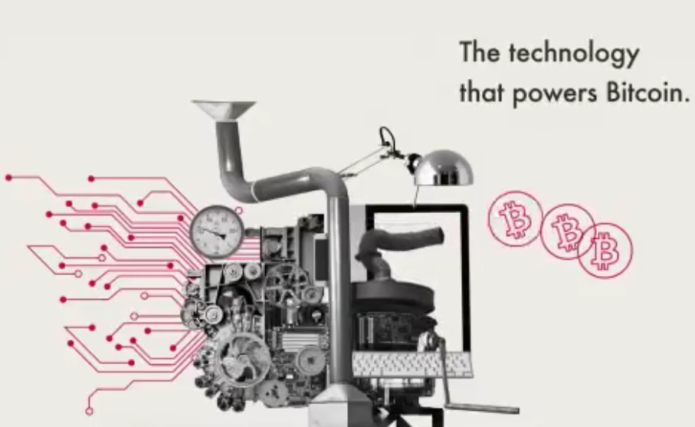
Bitcoin as a TRUST machine (CIGI view)

Slide 41
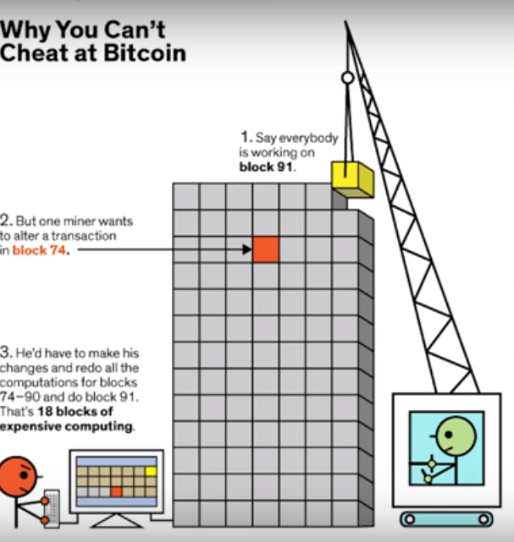
Credit Avery Carter

Slide 42


Slide 43
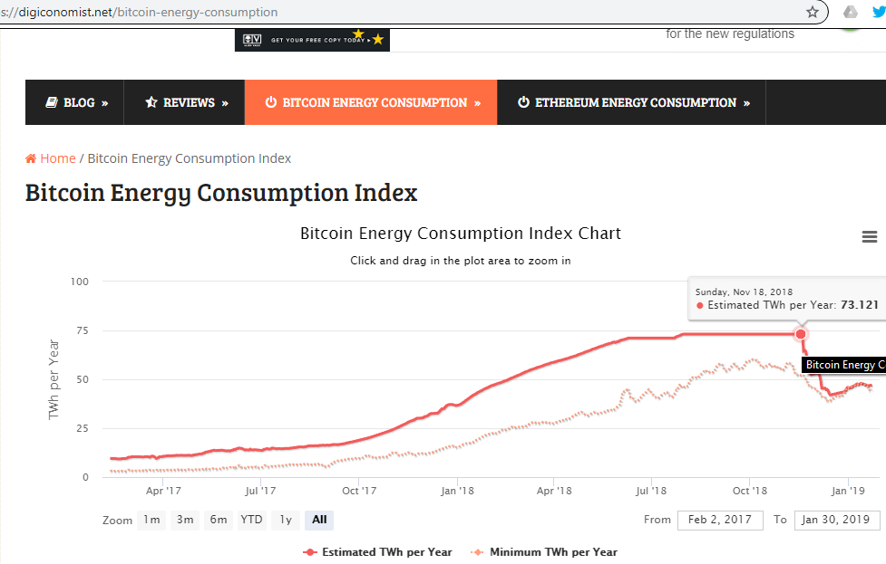

Slide 44
Bitcoin network competes to build next block
Step 4:
The winning node broadcasts the found block to all nodes (block contains a Tx that rewards the miner with bitcoins)

Slide 45
Bitcoin network competes to build next block
Step 5: Nodes easily verify block (hash < PoW target difficulty) + all Tx validity & if Tx are not already spent.
Step 6: Nodes accept the block (reach consensus) if they start building next block using the accepted block’s hash as previous block.
  If more correct blocks are received at approx the same time, nodes will extend the longest chain since it has the most PoW (hashing power) invested in (hard fork).

Slide 46
Chain Hard Fork
Happen when a longer chain containing previous block emerges (see next image)
Caused by PoW not finalizing the blocks
Trust in blocks increases as time goes by (rule of 1 hour waiting after Tx confirmation)

Slide 47
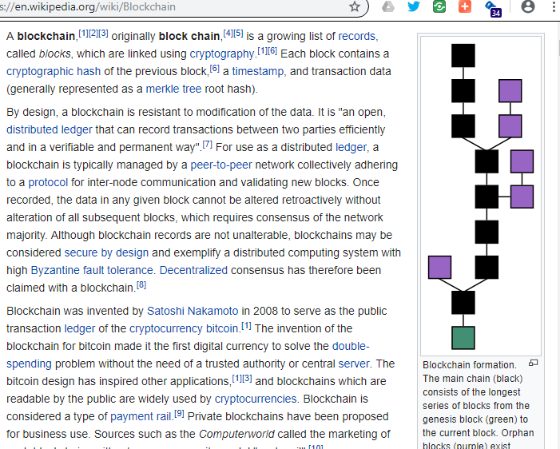

Slide 48
Blockchain v.s. DB
Data tamper protection by using heavy cryptography & chaining of blocks.
  Hash chain v.s. DB records.
Blockchain multi agent distributed consensus.
  No central but network ledger administration
    Authoritative DB without authority
    Network replaces bureaucracy
  Each blockchain node administers his copy of the chain by verification & appending.
  TRUST BUT VERIFY works since each block hash is a reassurance that enough consensus work has been done.
  Slow write = not scalable (limited Tx / sec)
  Ledger replication done by each block verification & history replaying form the genesis block (different from primary-backup model of distributed Dbs) [search youtube for “initial blockchain download”]

Slide 49
Bitcoin scripting limitations
Different types of Bitcoin applications (like P2P gambling, making own currency, decentralized exchange, financial derivatives, decentralized DNS, P2P insurance, color coins) required different types of Tx or features added to Bitcoin protocol (protocol evolution was impacted by applications).
  see "Vitalik Buterin - Ethereum" video on Texas Bitcoin Youtube channel @3:00

Slide 50
2nd generation of blockchains
Vitalik Buterin (former University of Waterloo 2nd year dropout) removes scripting limitations of Bitcoin by adding full programming feature to blockchain & other enhancements
  See account differences between Bitcoin UTXO & Ethereum, at: https://hackernoon.com/getting-deep-into-ethereum-how-data-is-stored-in-ethereum-e3f669d96033
SMART CONTRACT redefined = kind of object-oriented class that lives at a blockchain deployed account address & owned by deployer. Contract object functions can be called (via Tx) by invoking the contract address with required parameters.
  White paper released initially in November 2013.

Slide 51
Smart Contract

Slide 52
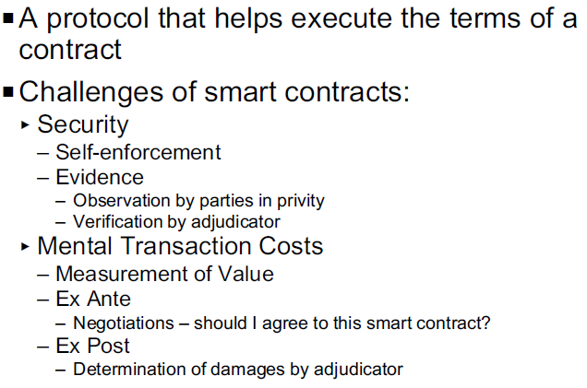
Smart Contract concept introduced in 1997 by Nick Szabo

Slide 53
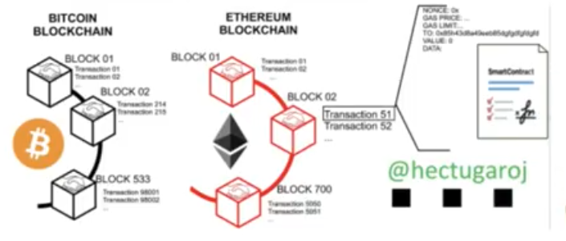

Slide 54
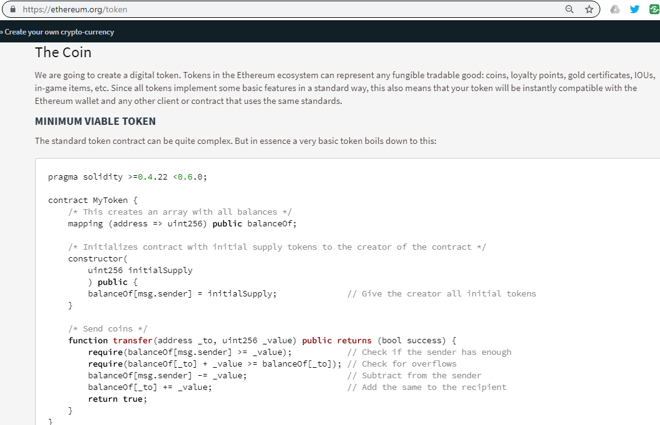

Slide 55
Ethereum Smart Contract
Kind of a script that reacts to inputs and changes the state of the blockchain
Introduces the notion of GAS (pay for contract running) to ensure execution finality
Distributed replicated logic running on EVM (Ethereum Virtual Machine) on each node
Offers a way to establish an agreement between UNTRUSTED parties due to decentralization & immutability feature
Can be used to launch ERC20 tokens (Initial Coin Offering, ICOs mania)
Used to implement Smart Property
  Blockchain controls ownership of real life objects
  see “Distributed Ledger” video on “code complexity” channel

Slide 56
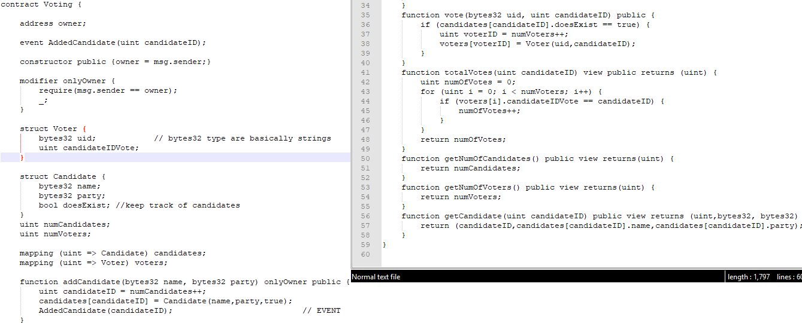

Slide 57
DApp = decentralized application
Made of:
  Backend = blockchain & smart contracts
  Frontend = app that initiate Tx or calls smart contract functions (usually from a GUI)
    Web3.js API usually used

Slide 58
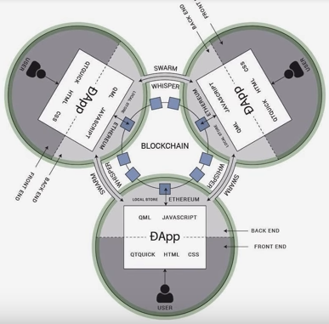
Ethereum decentralized web vision

Slide 59
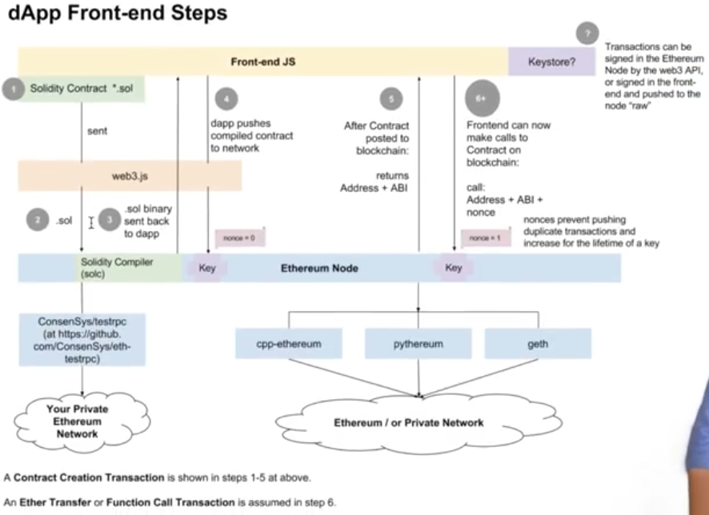
Credit Siraj Raval

Slide 60
Smart contract analogy with a real contract
    (Microsoft docs credits)

Slide 61
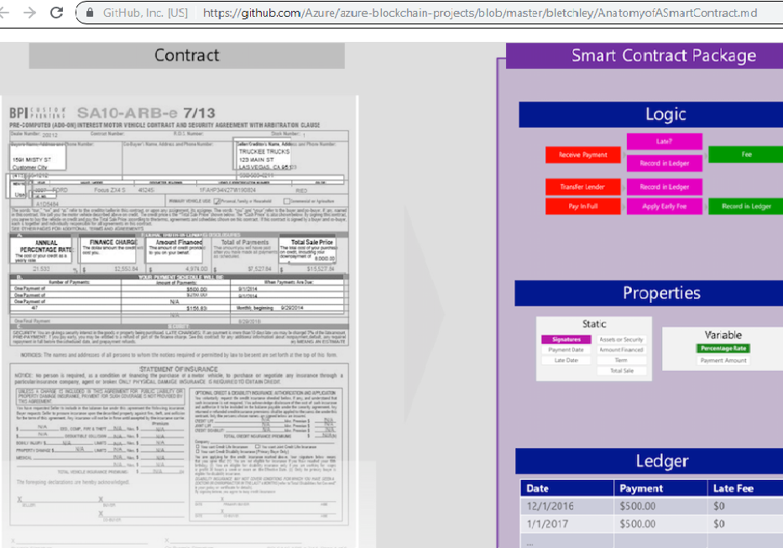

Slide 62
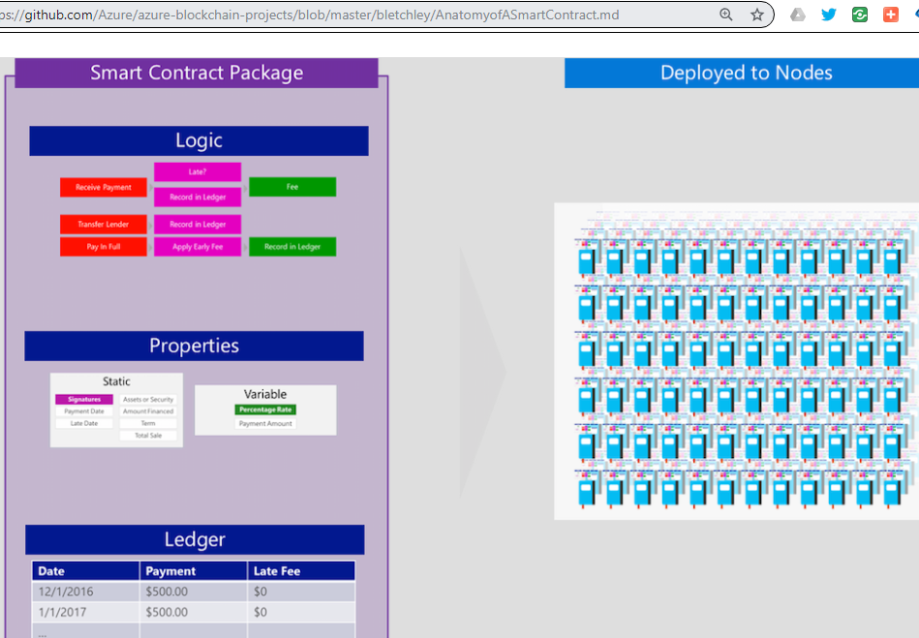

Slide 63
Smart Contracts
Any routine task done by a middle man can be automated (disintermediated)
Hard to modify since is recorded on the blockchain
Code is law (disputed by EOS blockchain’s “social arbitration”)
  Law is written in the smart contract
  Smart contract execution enforces the law
    Issue if smart contract has bugs since blockchain is immutable

Slide 64
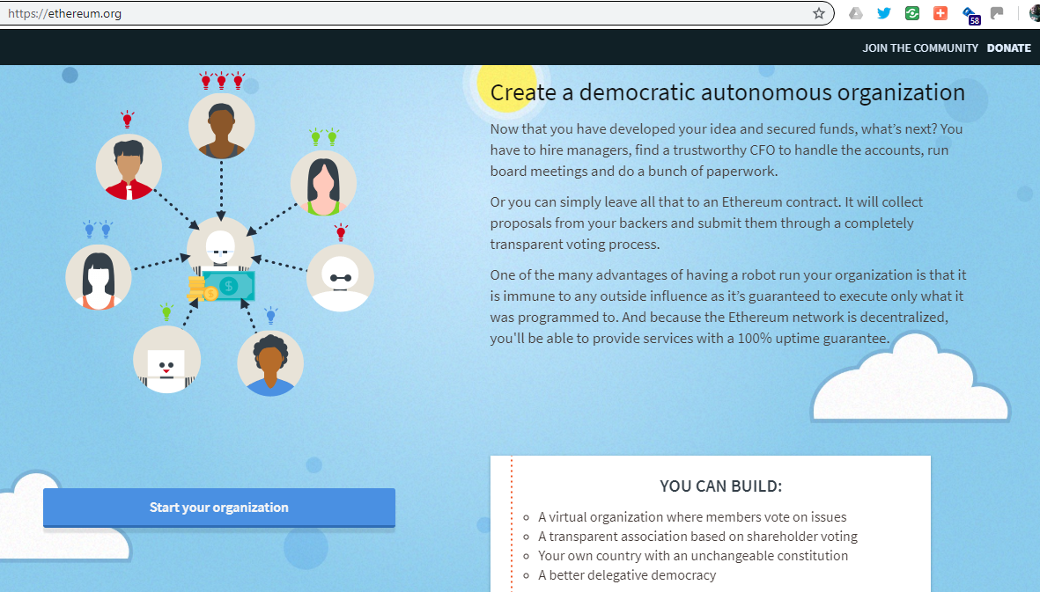
Cypherpunk vision with Ethereum Smart Contracts

Slide 65
Ethereum World Computer
Ethereum is like a "World Computer", since deployed smart contracts are stored in the blockchain by all nodes and are potential executable by all (via "messages" from clients or other smart contracts).
  Smart contracts change only the data on the blockchain
  Oracles are used to provide reliable data to the blockchain

Slide 66
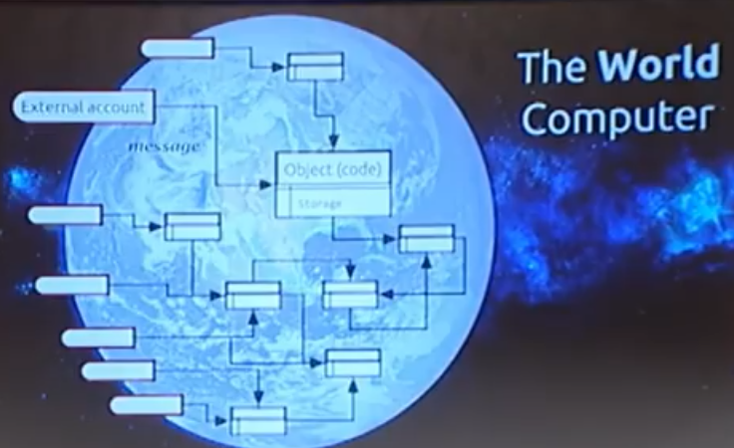

Slide 67
Blockchain use of huge data
Storing data on blockchain is expensive (due to gas use)
Common practice is to store on blockchain a reference to the data (hash) that is hosted offchain e.g. on P2P file sharing systems like Ethereum Swarm or IPFS InterPlanetary File System.

Slide 68
Blockchain V2 = Transfer of value blockchains
Blockchain evolved from a payment network to a value transfer network.
Any application with a transactional nature can be implemented or ported as a GUI interface to a collection of smart contracts on a blockchain offering the decentralization & trust features.
Applications examples: voting, escrow, identity, crowdfunding, IoT, assets tracking (land & car registrations), real estate, auctions, supply chain tracking (diamonds, "farm to table"), insurance, proof of authenticity, etc.

Slide 69
Blockchain V2 vs DB
Data query is challenging
Smart contracts
  Look like stored procedures but are different
  Modify only data on the blockchain due to TRUST requirements
  Trusted interaction with external world is challenging
    Cannot open a socket to get data
    Need to use oracles
  Distributed blockchain ORACLES (middleware) implementation issues:
    Trusting input data & oracle audit issue

Slide 70
Blockchain invariants
Write in blocks of Tx to be able to crypto secure it & minimize number of links in the chain. The block size is an open debated issue.
Tamper Resistance due to heavy cryptography use at Tx & block level
Distributed Governed Write via consensus protocol
Immutability (permanent write) due to all of the above

Slide 71
Blockchain V1/V2 variants
Deviations from Bitcoin’s initial blockchain design:
Advanced SMART CONTRACTS. Ability to store & run programs on blockchain written in modern programming languages like Solidity, Viper, C#, Java, C++, Go, JS, Haskell, etc.).
Identity (no anonymous users).
Private / Closed / Enterprise / Permission networks. Classical IT security (PKI) is used to allow authorized blockchain access / use
  Allowed users can see / audit the ledger
Consortium Enterprise blockchains
  Encrypted ledger. Discriminate who can see the ledger
Different Trusted Network Write (consensus) protocols

Slide 72
Scaling Tx/sec by faster consensus types
PoW = hard to do, easy to verify
Proof Stake (PoS): miners put assets at stake. Instead of using expensive hardware to solve the computation problem, PoS approach has no mining or requirement for work. It uses a pre-determined algorithm to identity the node that generates a new block.
Proof of Authority: trusted nodes validate blocks to speed up consensus. Put reputation at stake.
Proof of Activity (PoA): This is a combination of Proof of Work and Proof Stake. The blocks are created by the miner without any transactions using PoW. PoS is used to complete the block with the transactions.
Proof of Burn (PoB): Instead of spending money on expensive hardware, you send the money/valuables to location that cannot be retrieved, basically burning the currency.
Proof of Capacity (PoC): Depends on the hard disk space. The more capacity you have the more chances you will have to create the block.
Proof of Elapsed time (PoET): Created by Intel. Like Proof of Work but consumes much less electricity. Instead of participants solving “cryptographic puzzles”, the algorithm uses a Trusted Execution Environment (TEE) to ensure blocks get produced in random lottery order, but without requiring any work.
Practical Byzantine Fault Tolerance (PBFT): used by IBM Hyperledger consortium private blockchain & Quorum
RAFT distributed consensus protocol: used by J. P. Morgan Quorum (Ethereum based) blockchain
  (partial credit to Microsoft documentation)

Slide 73
Types of Blockchains
PUBLIC - Anybody can join this network.
PRIVATE – built locally to allow document sharing at organization level. Access to the network is controlled.
CONSORTIUM or Federated Blockchains - More than one party controls the access to the network. Built to share documents & process automation across businesses.

Slide 74
Business Blockchains
Common data layer & logic to facilitate trusted data exchange between businesses
No currency usually, but fair play incentive is driven by identity, reputation & liability
Solve Tx scalability & privacy
Private (permission) blockchains secured with businesses IT PKI (Public Key Infrastructure) security infrastructure
Examples:
  Corda (used for privacy & finality)
  Microsoft’s Confidential Consortium (CoCo) blockchain framework
  J.P. Morgan Quorum Ethereum blockchain
  IBM Hyperledger open source blockchain
  AWS Blockchain Template for Ethereum & Hyperledger

Slide 75
Microsoft Azure Blockchain solutions
Makes it easy to integrate blockchains into existing enterprise ecosystem.
Microsoft Blockchain as a Service in Azure Marketplace allows creation of 4 types of ledgers (Ethereum, IBM Hyperledger, Corda & Quorum).
Microsoft Azure Blockchain Workbench allows building Consortium Blockchains to automate business processes between enterprises (parties) with enterprise integration, keys management, smart contract authentication API (via easy REST calls) features.
Smart Contracts Formal verification tool.
Decentralized identities.

Slide 76
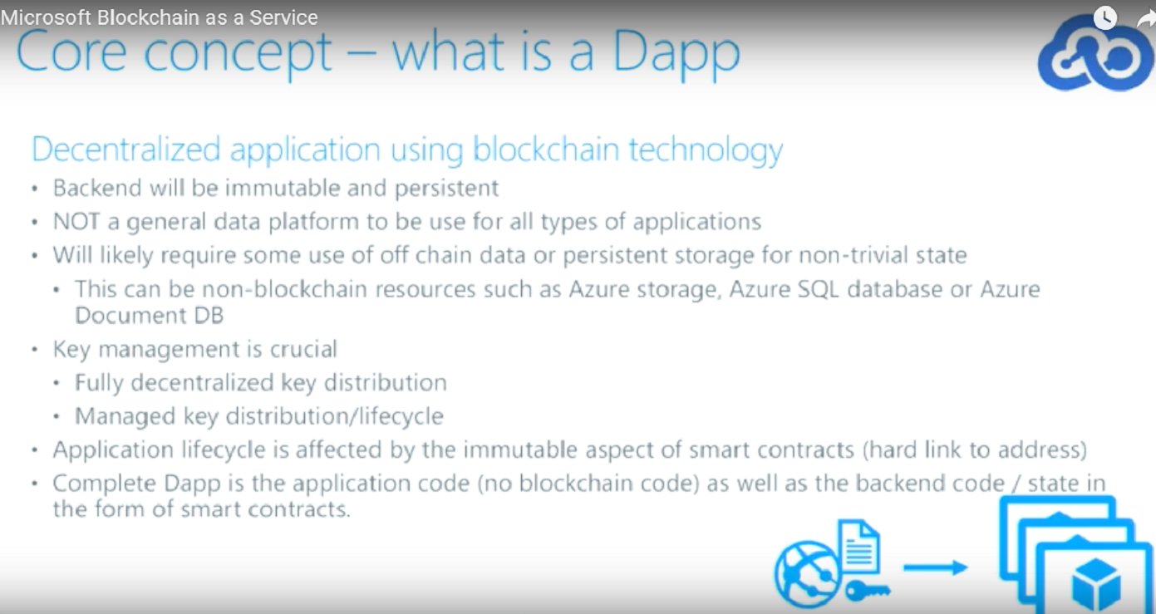
Microsoft enterprise Dapp solution

Slide 77
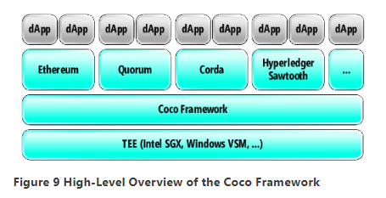

Slide 78
Enterprise Ethereum Alliance (EEA)
Specifies Enterprise Ethereum (EE)
a set of Ethereum extensions
addresses enterprise requirements for
  scalability
  security
  data privacy.

Slide 79
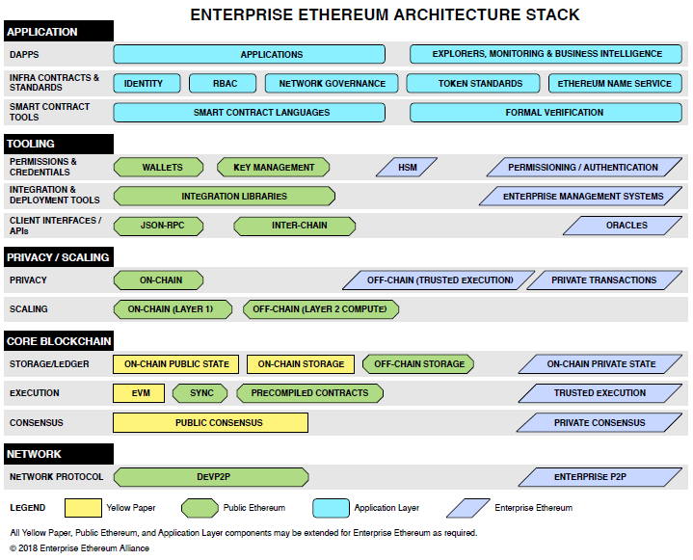

Slide 80
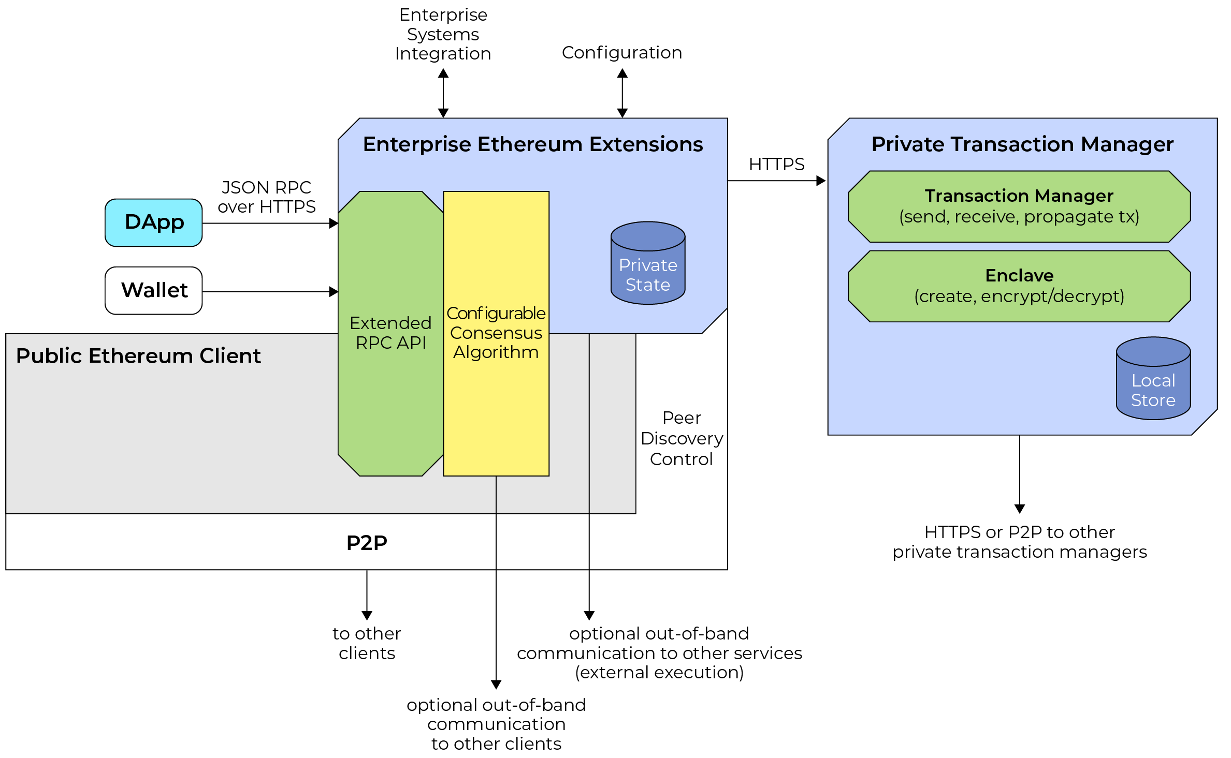

Slide 81
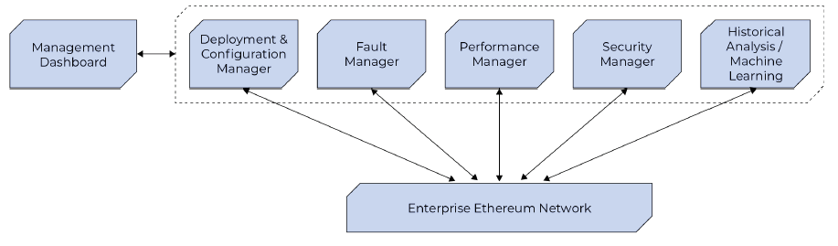

Slide 82
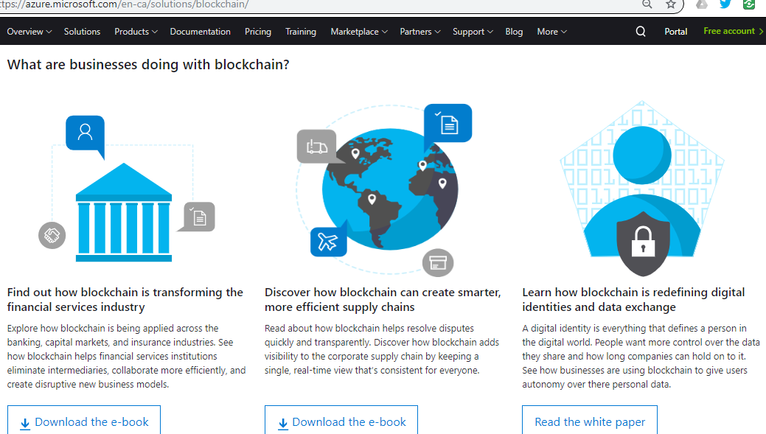

Slide 83
Blockchain empowered multi-party supply chain
Provenance attestations
  Product tracing from production to consumer (farm to table) removes ambiguity, increases transparency, audit & accountability.
    Microsoft example, next.

Slide 84
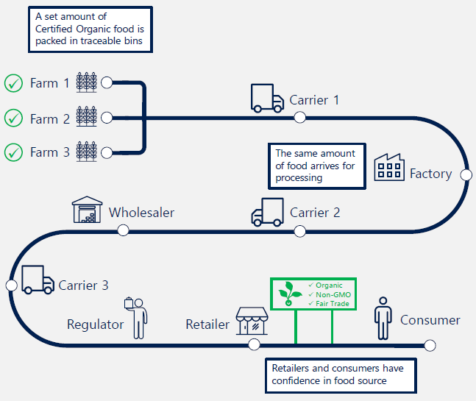

Slide 85
Blockchain empowered supply chain
Monitoring of product quality & safety
  IoT enabled monitoring of humidity & temperature example

Slide 86
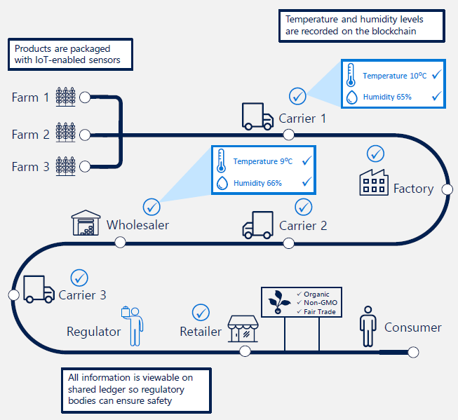

Slide 87
Blockchain empowered supply chain
Disputes resolution
  Sourcing, monitoring conditions & delivery timeline can be setup in smart contracts between members of the supply chain
  Events triggered by IoT sensors are immutable recorded on the blockchain ledger
  Smart contracts execution uses recorded ledger info, enforces contractual agreements & trigger non-compliance actions

Slide 88
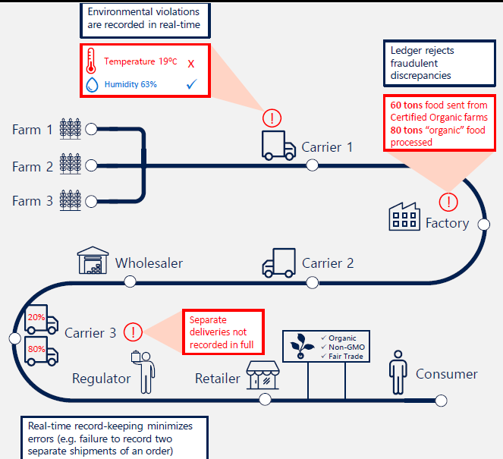

Slide 89
Microsoft Azure Blockchain solutions
Make it easy to integrate blockchains into existing enterprise ecosystem.
Microsoft Blockchain as a Service in Azure Marketplace allows creation of 4 types of ledgers (Ethereum, IBM Hyperledger, Corda & Qorum).
Microsoft Azure Blockchain Workbench allows building Consortium Blockchains to automate business processes between enterprises (parties) with enterprise integration, keys management, smart contract authentication API (via easy REST calls) features.
Smart Contracts Formal verification tool.
Decentralized identities.

Slide 90
Microsoft’s Confidential Consortium blockchain
Addresses: Scalability, Confidentiality & Governance.
Ethereum transactions are encrypted on a trusted execution platform (hardware conclave as a service).

Slide 91
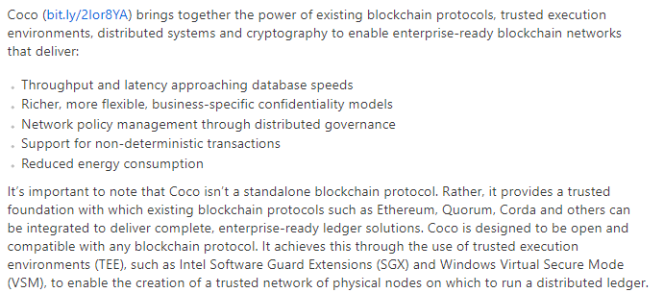
Microsoft’s Confidential Consortium blockchain

Slide 92
Microsoft sample of enterprise blockchain use
Refrigerated Transportation supply chain sample.
Ice cream delivery supply chain Dapp sends a phone notification when shipping contractual temperature is out of range.
  https://github.com/Azure-Samples/blockchain/blob/master/blockchain-workbench/application-and-smart-contract-samples/refrigerated-transportation/ethereum/RefrigeratedTransportation.sol

Slide 93
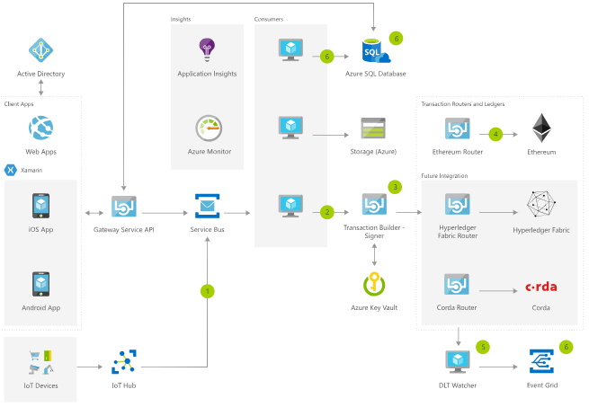

Slide 94
Blockchain vs DB in enterprise
Common infrastructure between parties with built in cryptoeconomics incentives
  Solves integration of heterogeneous IT infrastructures
  Builds trust, transparency & accountability
Secure & decentralized = highly available
Why general DB if blockchain is already a specialized DB towards Value transactions with lots of accumulated knowledge
Bigchain DB approaches blockchain from DB perspective
Cannot do easy query like a DB
Google’s Level DB used both by Bitcoin clients & Ethereum

Slide 95
Blockchain platforms
Andreas Antonopoulos metaphors paraphrased:
  Blockchains are building the DIGITAL PYRAMIDS of our time writing in stone the digital truth
  Embrace, instead of fighting them since:
    Blockchains are in the beginning state of INFRASTRUCTURE INVERSION similar with other inventions like: cars, electricity & Internet when the new technology adversarially emerges on top of the old, becoming the future foundation for the old one.
    Blockchain is a DISRUPTIVE technology that will enable a permissionless TSUNAMI of INNOVATION.

Slide 96
Takeaway summary
Blockchain advantages:
  is a specialized append-only, decentralized, transactional, PERMANENT, TRUSTED, fault-tolerant & shared DB, with:
    built-in cryptographic tamper resistant security & trust
      Chain content is fingerprinted on each block
    multi-party consensus WRITE feature
    and built-in incentives
      towards correct consensus data write (TRUST MACHINE)
  Integration platform for heterogeneous data sources
    Enabling process automation across businesses
Disadvantages:
  Low transactions per second (due to consensus)
  Not easy to input reliable data into blockchain (need for decentralized auditable oracles)
  Not easy to query data in DB style
  Need $$$ (or crypto coins) to use it, sometimes.

Slide 97


